Slide 1

Module Overview
Digital Forensics
Diploma in CSF/IT
Year 2/3 (2022/23), Semester 4/6
Notes:
Left-hand Bar – Replace FSP by your module code and X by the lecture number.
Replace Lecture Title
Replace < Module Name >
Replace Year and Semester if necessary

Slide 2
Objectives
At the end of this, you will get to know more about:
Module Synopsis
Module Topics
Assessment Details
Guide for Practical Lab

Slide 3
Module Synopsis
This module gives an insight to the process of forensics investigation.
It covers the various types of computer-related crimes, techniques of gathering electronic evidence, and recovering of deleted data.
Students will make use of advance commercial forensic tools (EnCase) to perform forensic investigation.

Slide 4
Module Synopsis – cont.
Besides the tools & techniques of investigation, students will be taught sound forensic investigation methodology and the proper handling of evidence.
The module will also cover aspects of law and policies applicable to digital forensics.
In this module, students are assessed by coursework only.

Slide 5
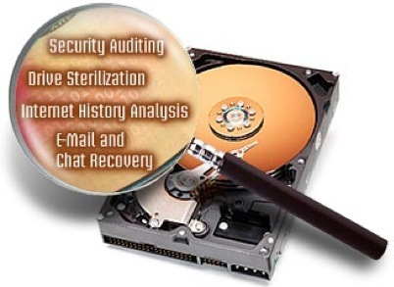
Module Topics
Computer Forensics & Digital Evidences
Investigative Process
Evidence Extraction & Analysis
Windows Artifacts
Windows File System
NTFS Analysis
Law & Computer Forensics
Computer Forensic Reporting
Live Response

Slide 6
Teaching Plan & Assessment
Teaching Plan:
Teaching Plan will be posted in POLITEMALL | DIGITAL FORENSICS | Content | Module Information Tab
Assessments:
Common Test, Quiz format, Assignment write-up, cover page, e-Poster template will be posted in POLITEMALL | DIGITAL FORENSICS | Content | CourseWork Tab

Slide 7
Assessment Outline
S/N | Coursework | Weightage (%) | Remarks
1. | Common Test (Individual) | 30 | All Week 1-8 materials
2. | Assignment (Group & Individual) | 40 | Group & Individual Week 3-17
3. | CA (Individual) | 30 | 2 online quizzes (10% each) 1 in-class practical assessment (10%)
Total |  | 100

Slide 8
Practical Lab
A folder has been created at each PC for each class (under C:\Users) as follows. You are allowed to access only your class folder.
DF Student P01,
DF Student P02,
Etc.
You are strongly encouraged to stay at the same workstation for practical lab to continue the work from week before.
You MUST bring your own storage device (flash drive or portable hard drive) to backup your work each week.
The lab is shared by more than 100 students!

Slide 9
Q & A

